Slide 1
TEXTUAL ANALYSIS OF MOVIE REVIEWS
TEAM 12
Chu Wang
Di You
Saranya Manoharan
Rishitha Kiran

Slide 2
INTRODUCTION
A movie review is the opinion of someone who has seen a particular movie and written an article about the movie.
Before many of us choose a movie, we often seek out the opinions of other who have already seen it.
Human mind can read and understand whether a review is positive but for movie studios it is difficult to hire employees to simply read and judge movie opinions.
Machine Learning - process, reliably extract and classify the sentiment of unstructured movie reviews.

Slide 3
OBJECTIVES
Download the data set
Preliminary Sentiment Analysis on Movie Reviews
Explore sci-kit – TfidfVectorizer Class
Machine Learning Algorithms
Finding the right plot

Slide 4
Preliminary Sentiment Analysis
Load Files
Randomly split movie reviews into 2: Data_train and Data_test (75%-25%)
Build Vectorizer Classifier Pipeline (TfidfVectorizer)
Eliminate rare and most frequent tokens
Fit Linear Support Classifier with relatively high frequency
Determine grid search token set for text files
Words (1gram) or words and pairs (2 gram)
Perform Grid Search Cross Validation

Slide 5
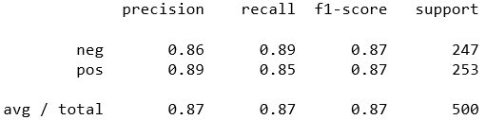
Preliminary Sentiment Analysis
Grid Search CV scores
We see that the linear SVC pipeline is more accurate when it considers both words and pairs of words on the training data.
Classification Report

Slide 6
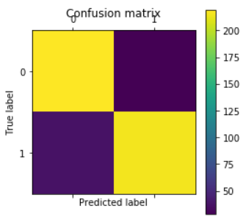
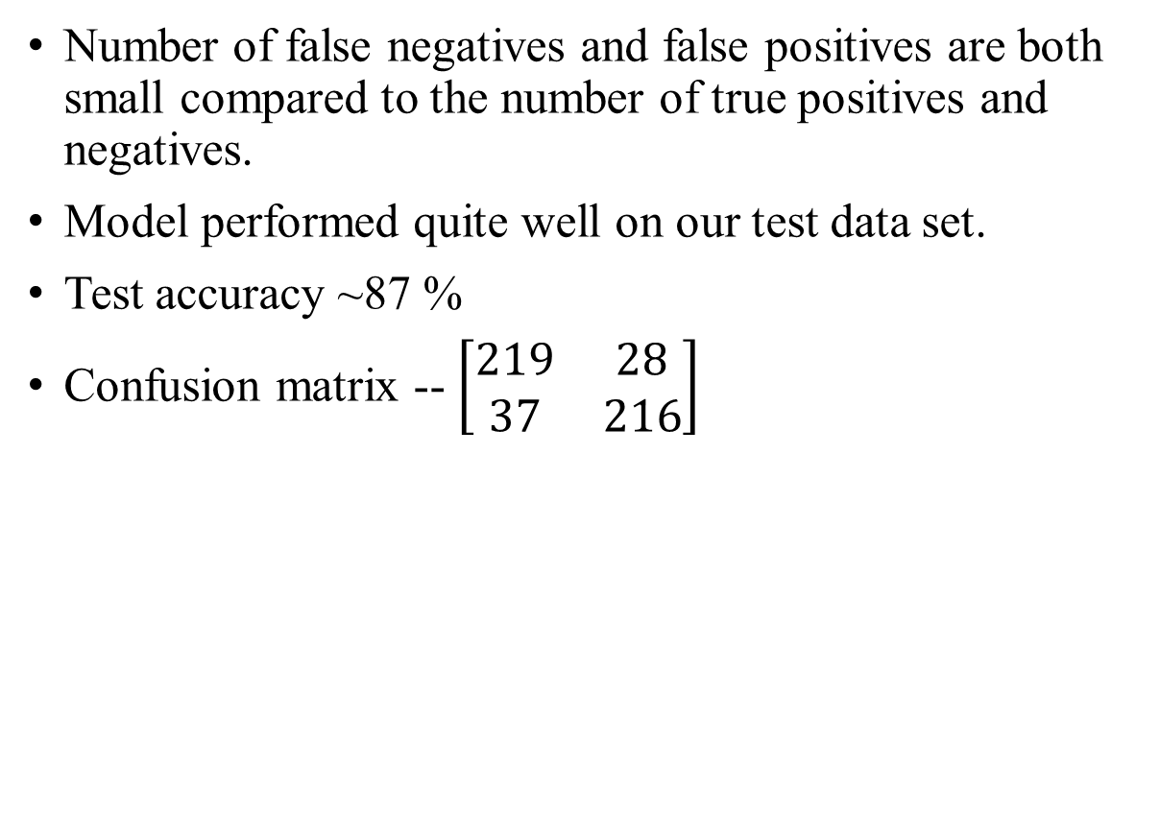
Preliminary Sentiment Analysis
Number of false negatives and false positives are both small compared to the number of true positives and negatives.
Model performed quite well on our test data set.
Test accuracy ~87 %
Confusion matrix -- $\left[\begin{matrix}219 & 28 \\ 37 & 216\end{matrix}\right]$

Slide 7
Explore sci-kit TfidfVectorizer Class
TF-IDF is a numerical statistics term that is intended to reflect how important a word is to a document in a collection or corpus.
TF: Term frequency, the number of times a term occurs.
IDF: Inverse document frequency, the specificity of a term can be quantified as an inverse function of the number of documents in which it occurs

Slide 8
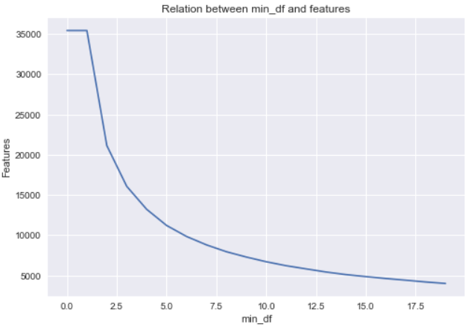
RELATIONSHIP BETWEEN MIN_DF AND FEATURES
min_df:
When building the vocabulary ignore terms that have a document frequency strictly lower than the given threshold
OBSERVATION:
When min_df is larger, the shape of vectorized result is smaller and we will get less features.

Slide 9
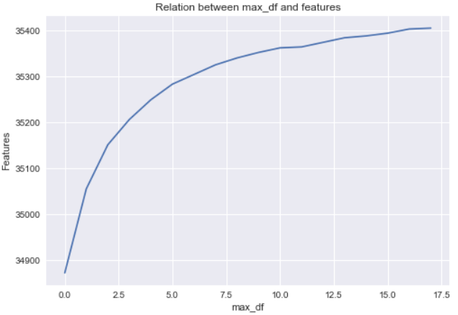
RELATIONSHIP BETWEEN MAX_DF AND FEATURES
max_df:
When building the vocabulary ignore terms that have a document frequency strictly higher than the given threshold.
OBSERVATION:
When max_df is smaller, the shape of vectorized result is smaller and we will get less features.

Slide 10
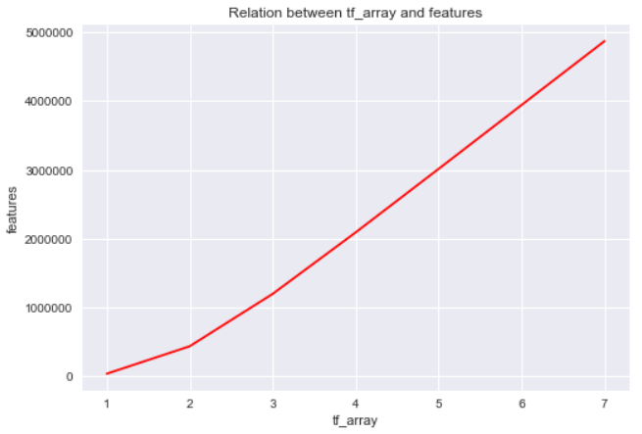
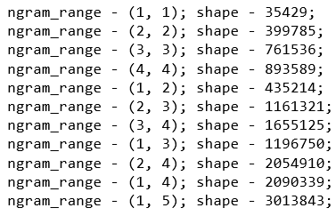
N_GRAM_RANGE AND FEATURES
An n-gram is a contiguous sequence of n items from a given sequence of text or speech.
OUR RESULTS:

Slide 11
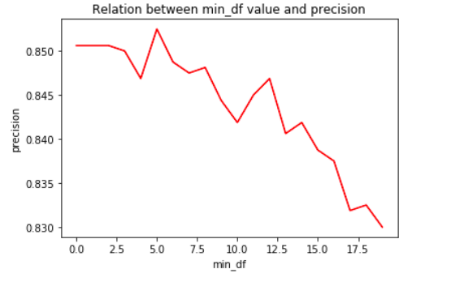
CHOOSING THE PARAMETERS: CROSS_VALIDATION
Min_df: cross-validation with the range 0f 20
Higher min_df value tends to result in lower precision scores
best_parameter: min_df = 5

Slide 12
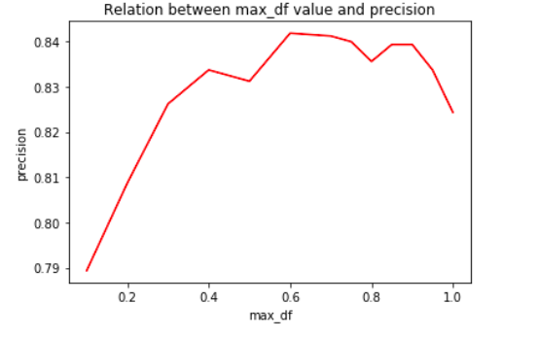
CHOOSING THE PARAMETERS: CROSS_VALIDATION
Max_df: cross-validation with the range of 1.0(float)
precision remains high when max_df is between 0.4 and 0.9
Including the words that appear in almost all document makes the performance worse
best_parameter: max_df = 0.55

Slide 13
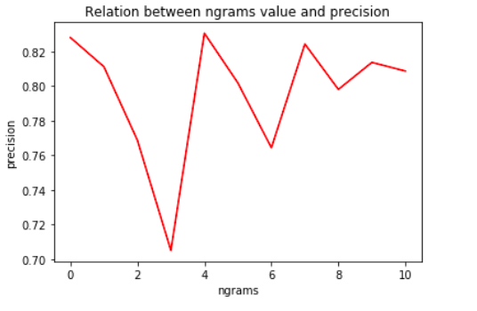
CHOOSING THE PARAMETERS: CROSS_VALIDATION
N_grams: cross-validation with 11 different values
Increasing the range of ngram does not result in a higher precision, i.e., ngram range of (1,2) has a higher precision than (1,5)
best_parameter: n_grams=(1,2)

Slide 14
PICK PARAMETERS FOR CLASSIFIERS
C of linearSVC: penalty parameter of the error term
Cross-validation on C = 0.1, 0.5, 1.0
Precision seems to be higher with C being a larger value
best_parameter: C = 1.0

Slide 15
PICK PARAMETERS FOR CLASSIFIERS
n_neighbors of KNN: cross-validation on 13 different values from 3 to 400
Generalization ability increases as the K increase, stability begins to drop after K exceeds 250, and the precision begins to drop after K over 350
best_param: K = 250

Slide 16
INTERACTING PARAMETERS?
We hypothesize that the parameter of classifiers would probably have interaction relationship with parameters in Tf-idf
Experimenting them all in Grid-search!
Best parameters:
C = 0.5, max_df = 0.6, min_df = 9, ngram_range: (1, 2)
n_neighbors: 250, max_df = 0.5, min_df = 9, ngram_range(1, 2)

Slide 17
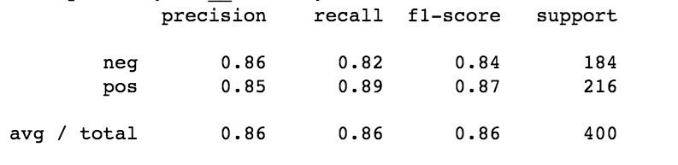
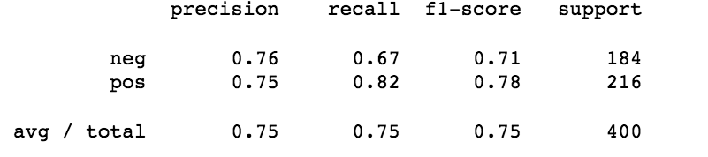
COMPARING TWO CLASSIFIERS
In general, LinearSVC classifier outperforms KNN classifier.
LinearSVC is stable and keep at a high level, which is not sensitive to the change of C
KNN classifier changes in a wide range with the change of N
LinearSVC
KNN

Slide 18
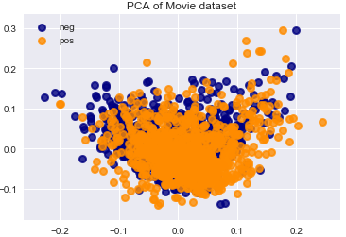
Finding the right plot
Principal component analysis(PCA)
Linear dimensionality reduction using Singular Value Decomposition of the data to project it to a lower dimensional space.

Slide 19
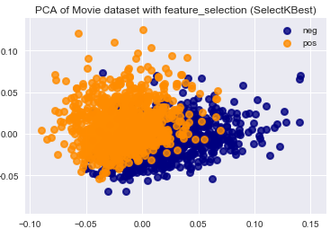
Principal component analysis(PCA) with Feature Selection
We made use SelectKBest method of scikit and extracted the 600 best features and then performed PCA.

Slide 20
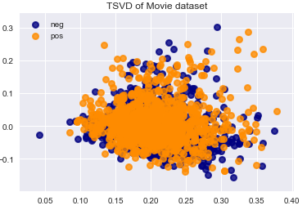
TruncatedSVD
We applied TruncatedSVD with its default linear kernel by reducing the number of components (features) .

Slide 21
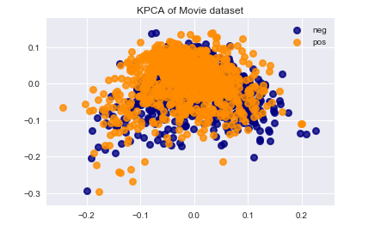
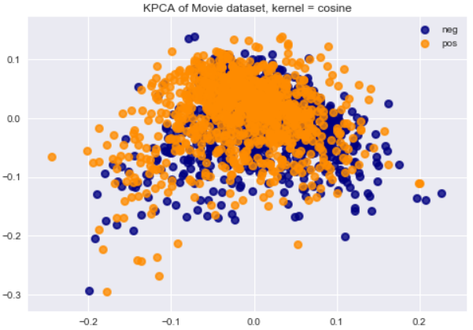
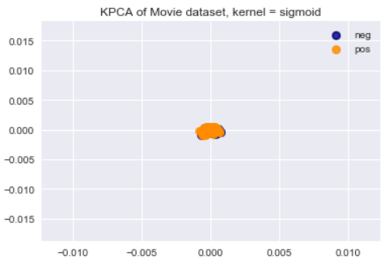
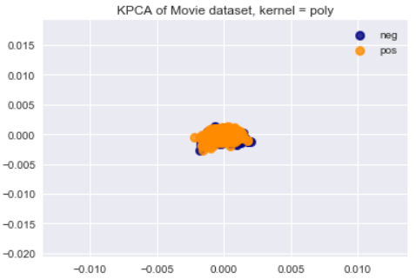
KernelPCA
We applied KernelPCA with its default value, with cosine value, with poly. value, and with sigmoid value .

Slide 22
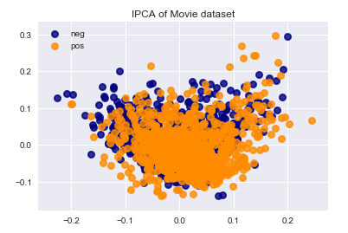
IncrementalPCA
We also tried applying IncrementalPCA but the result were similar and we could not find the right plot to separate the positive and negative reviews.

Slide 23
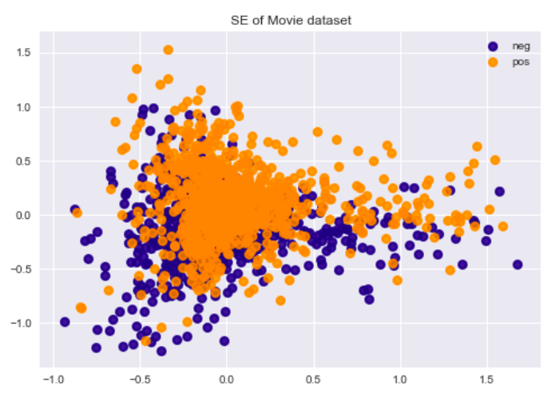
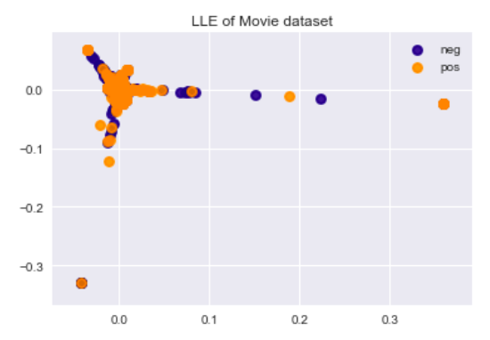
Manifold Learning Methods
We also tried applying several manifold learning methods but we could not find the right plot to separate the positive and negative reviews.
Spectral Embedding
Locally Linear Embedding

Slide 24
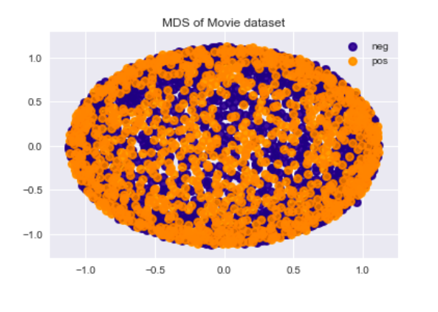
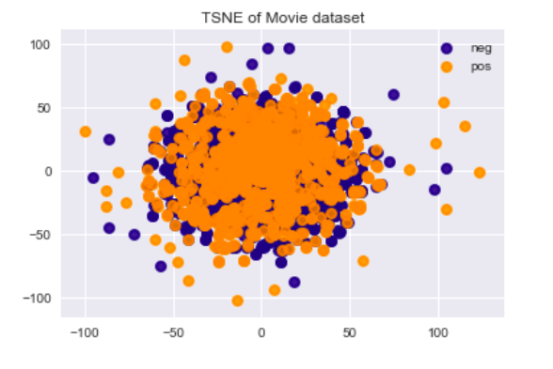
Manifold Learning Methods
We also tried applying several manifold learning methods but we could not find the right plot to separate the positive and negative reviews.
MDS
TSNE

Slide 25
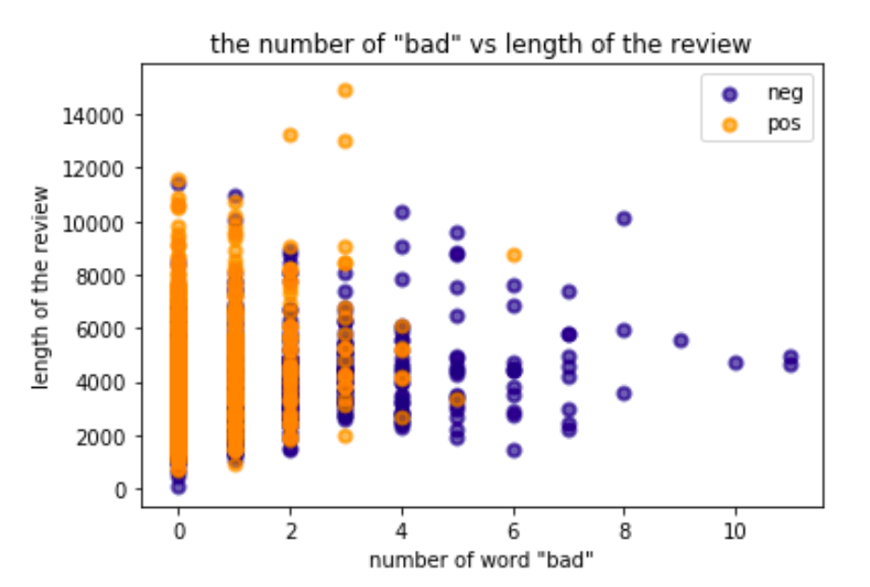
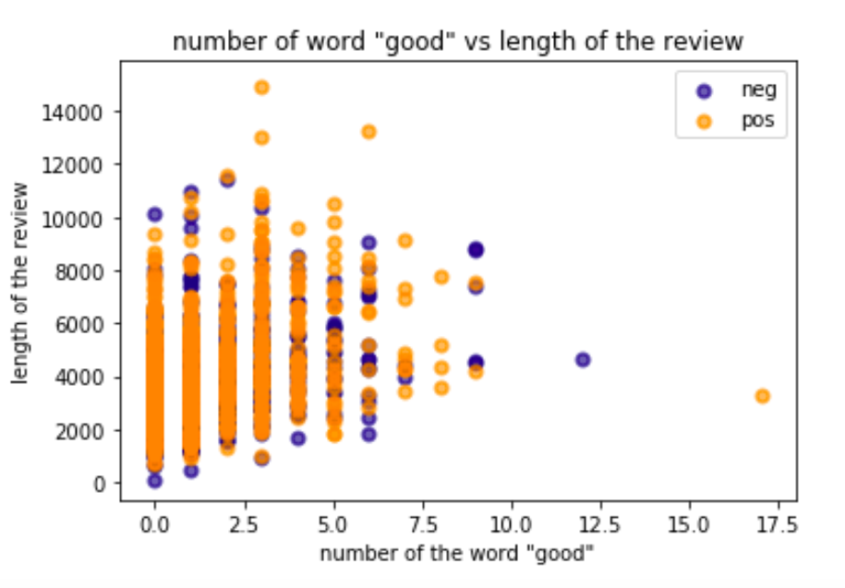
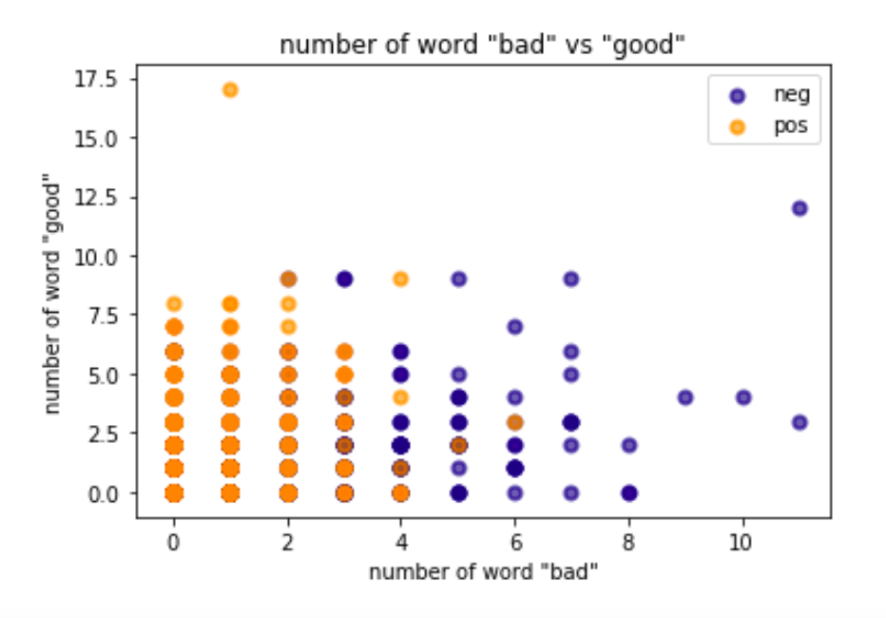
Using "good" and "bad" keywords
the number of “bad”
the number of “good”

